Slide 1

Prepared by group 1
Project
Adventure Works Sales Dashboard
02 March 2026

Slide 2
Project Objective
Analyze sales performance
Create KPIs (Sales, Profit, Orders)
Build dashboards using different tools
Compare tool performance

Slide 3
Dataset Overview
Adventure Works Sales Dataset
Data cleaning
Tables used (FactSales, DimCustomer, DimProduct etc.
Example : DimCustomer – 18,485 rows, 29 columns

Slide 4
KPIs Created
Example :
Total Sales
Total Profit
Total Orders
Profit Margin %
Top 5 Products

Slide 5
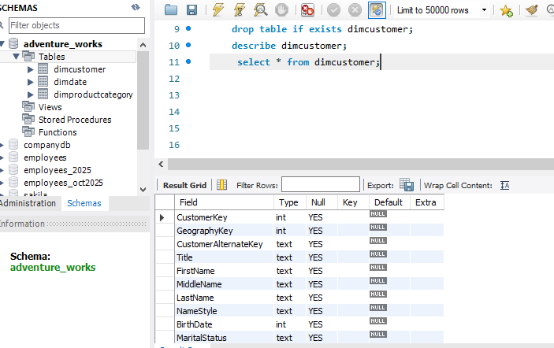
Data preparation using MySQL
Imported Excel data into MySQL
Created tables
Used JOIN queries
Generated aggregated results

Slide 6
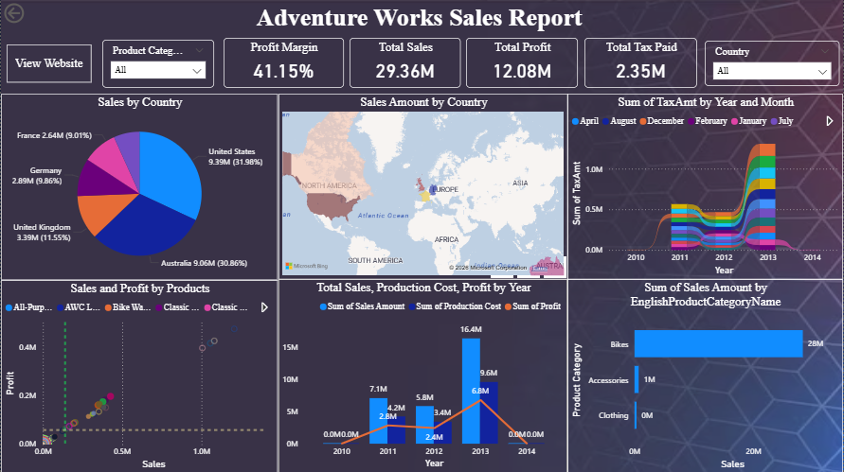
Power BI Dashboard
KPI cards
Slicers
DAX measures
Interactive visuals

Slide 7
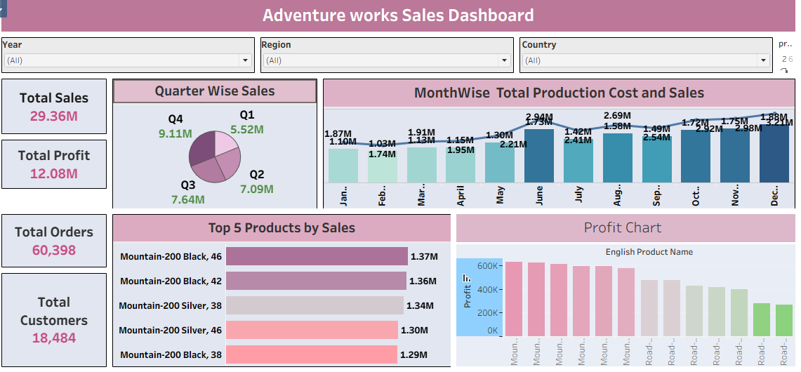
Tableau Dashboard
Interactive dashboard with filters
Drag & drop interface for quick visualization
Real time data analysis

Slide 8
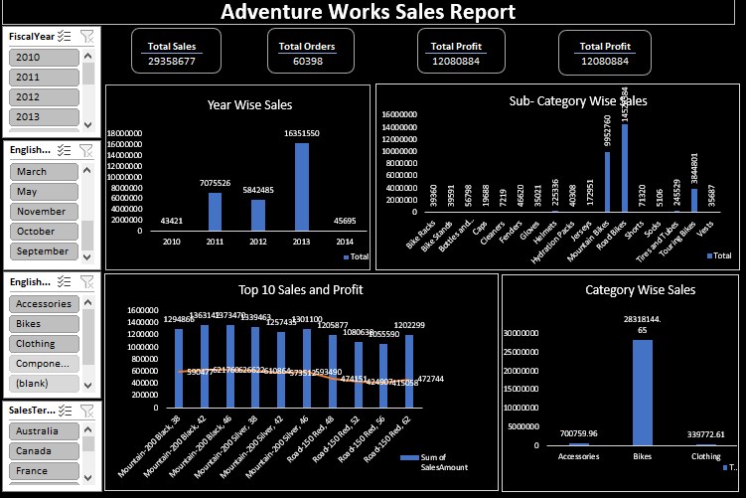
Excel Dashboard
Pivot tables
Charts
Data filtering
User - friendly

Slide 9
Tool Comparison Table
Feature | MySQL | Power BI | Tableau | Excel
Purpose | Data Storage | BI Reporting | Visualization | Basic Reporting
Handles Large Data | Yes | Yes | Yes | Limited
Visualization | No | Good | Excellent | Basic
Data Modeling | Yes | Yes | Limited | Limited
Cost | Free | Free/Desktop | Paid | Paid
Best Use | Backend | Business reports | Attractive Dashboards | Quick Analysis

Slide 10
Conclusion
SQL is best for backend data management.
Power BI is best for business intelligence reporting.
Tableau is best for visualization
Excel is suitable for small-scale analysis.

Slide 11
Thank you

